Slide 1

Creating An EC2 Instance

Slide 2
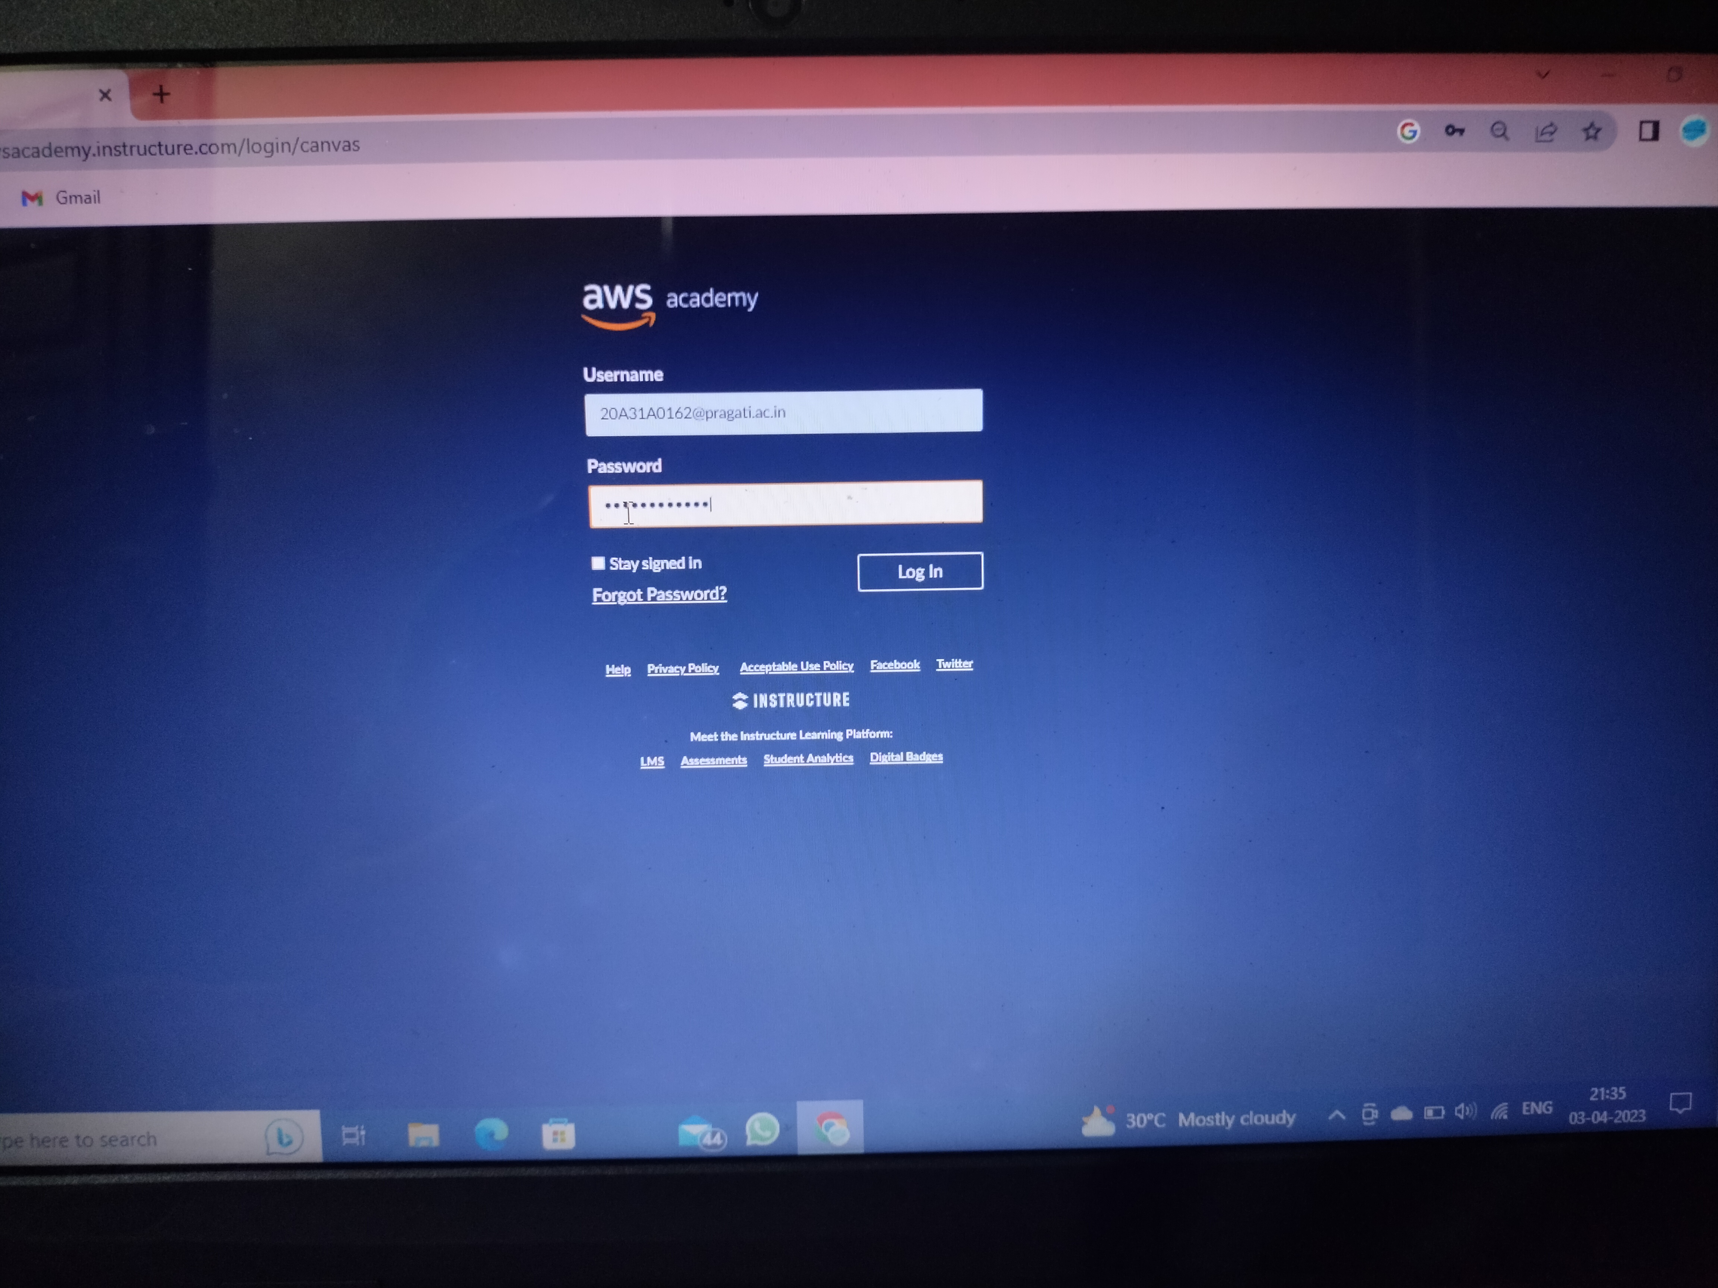
Step-1 : Firstly,we have to login to the AWS accounts with username and password

Slide 3
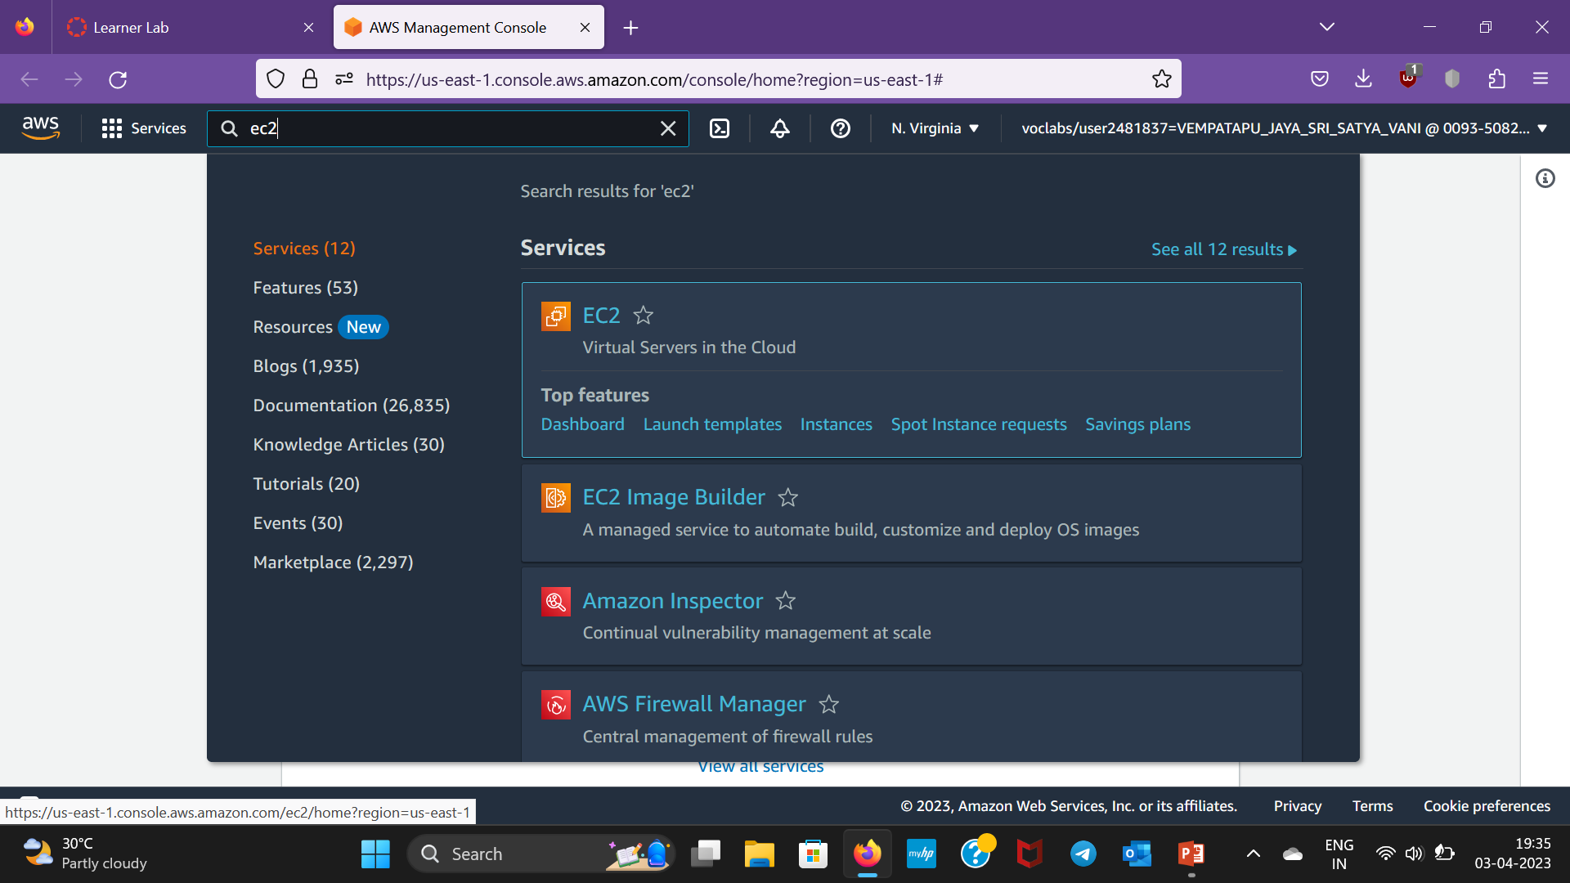
Step-2 : After logging in,click on services and search for EC2 instance and select it

Slide 4
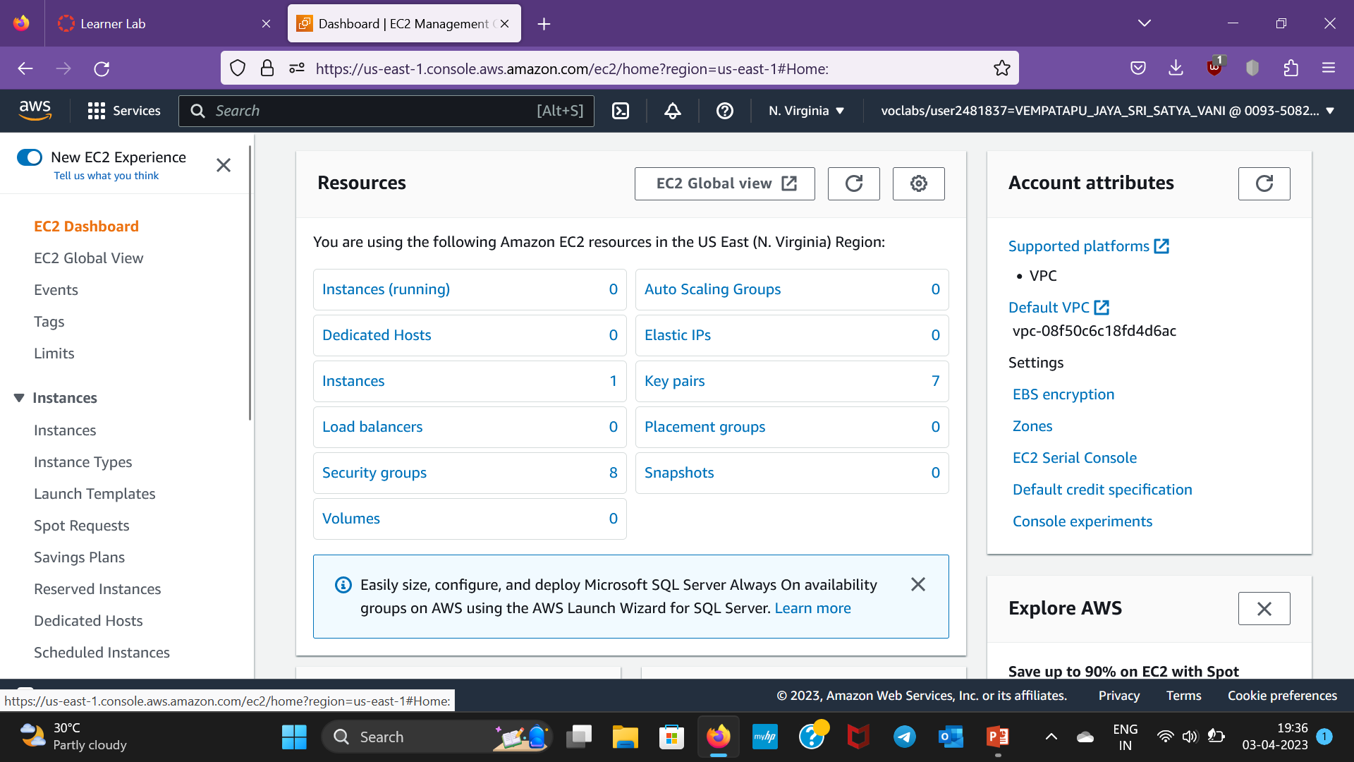
Step-3: After clicking on EC2 ,Ec2 dashboard appears

Slide 5
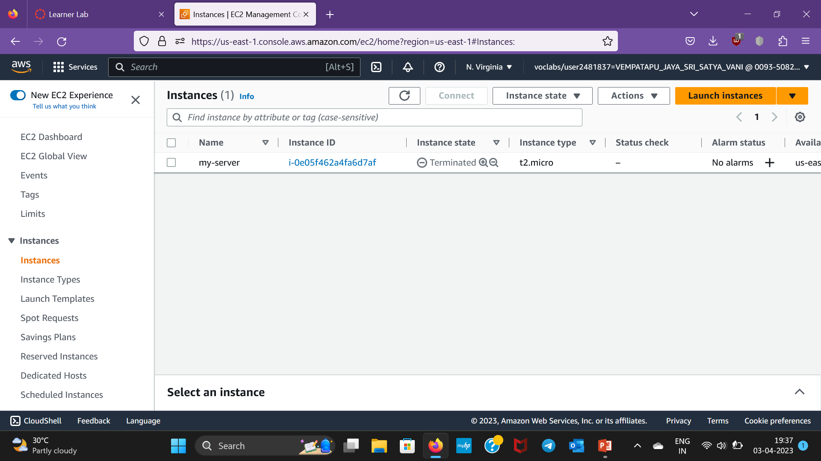
Step-4:Click on instances

Slide 6
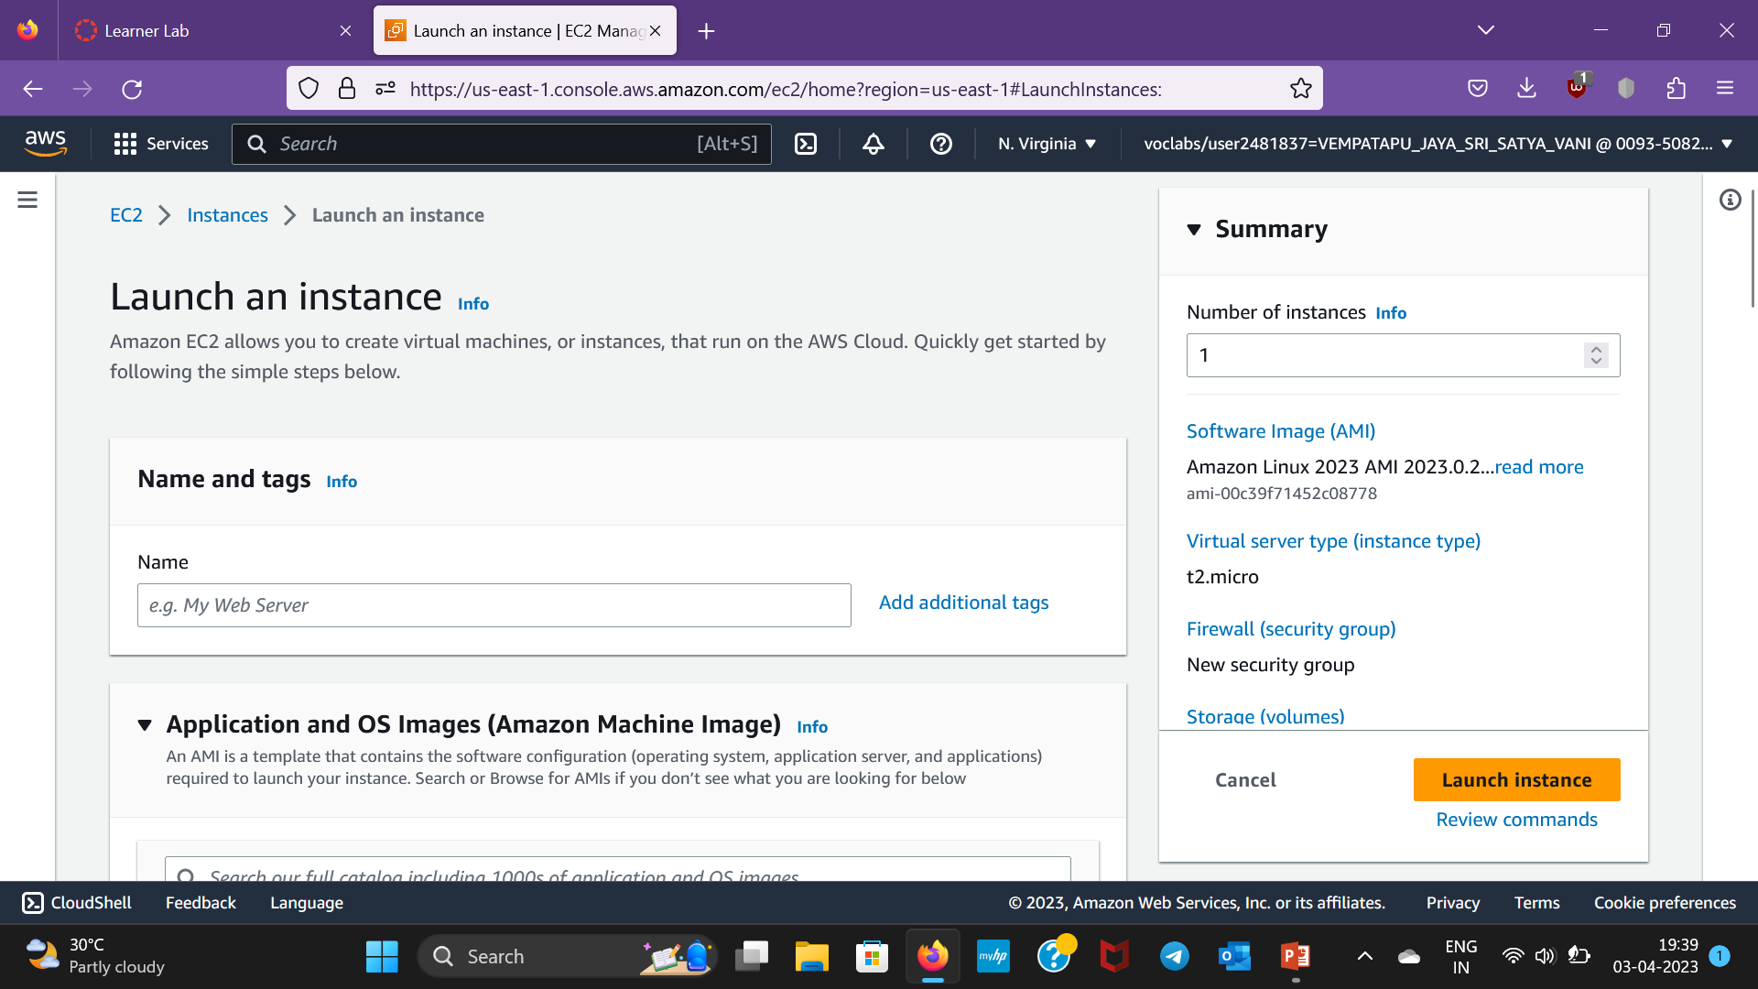
Step-5:Click on Launch Instance then a window appears

Slide 7
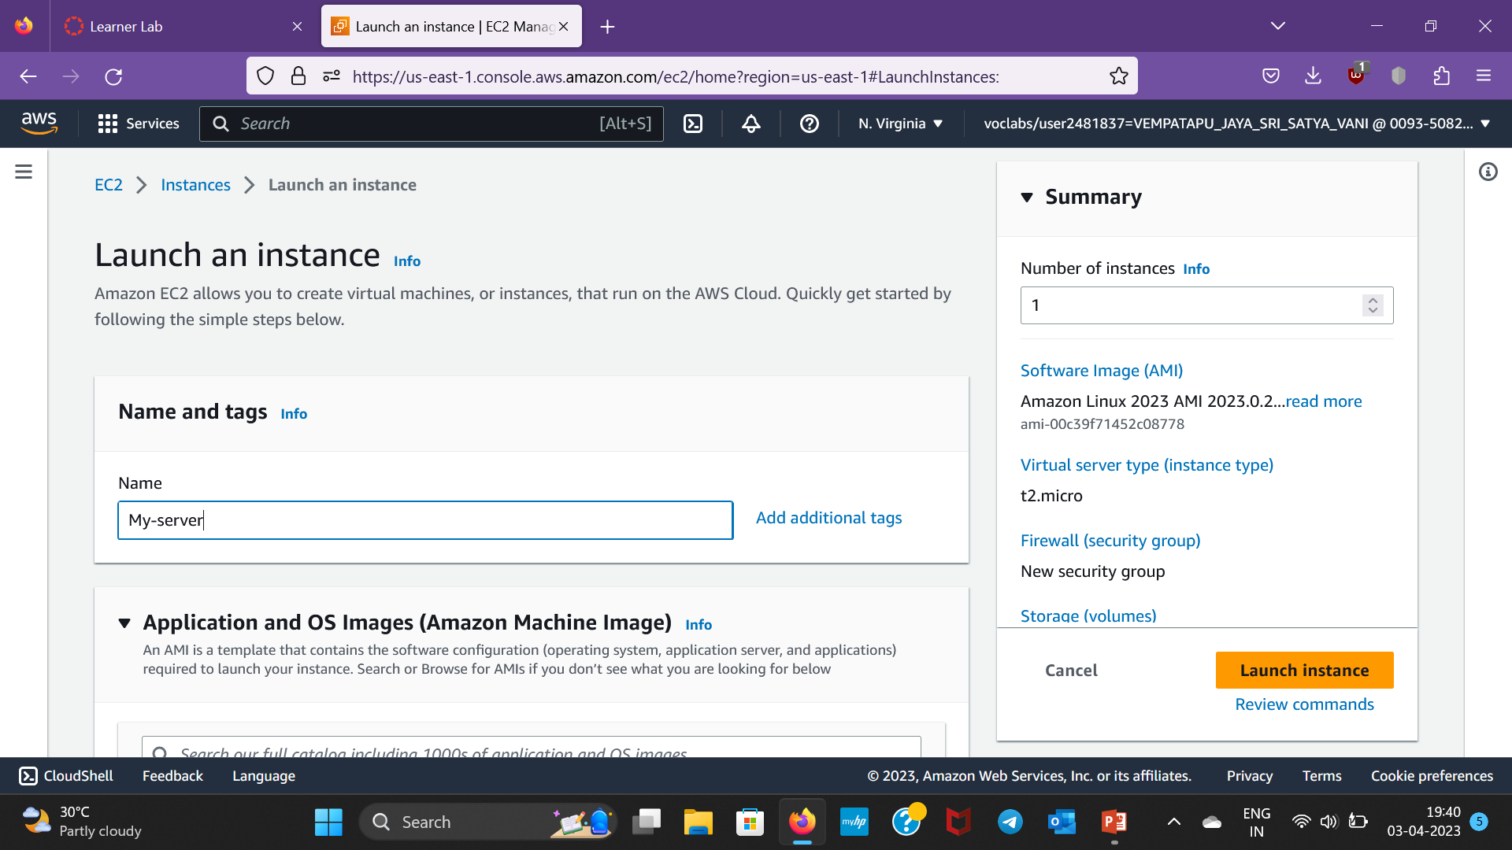
Step-6:Give a name to the server

Slide 8
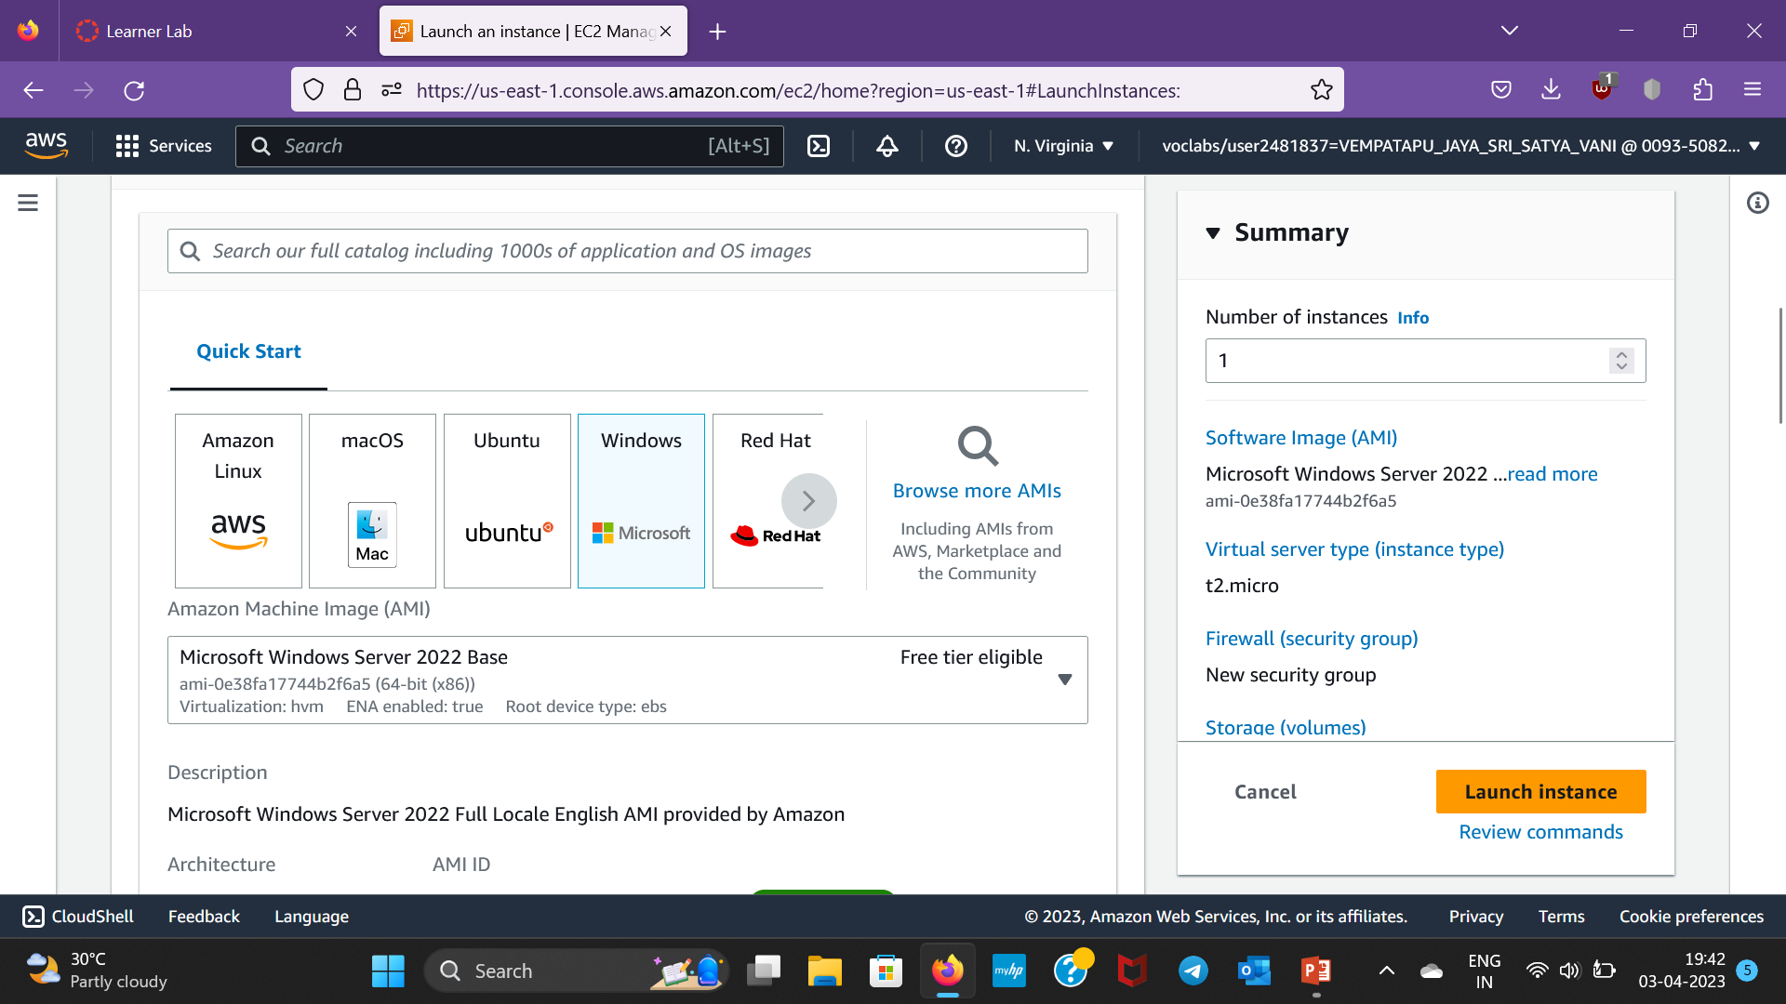
Step-7:Select AMI here,I select windows

Slide 9
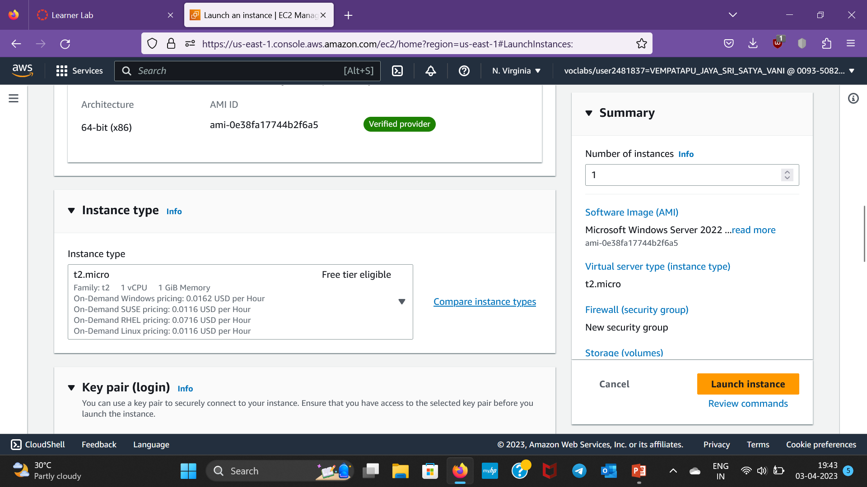
Step-8:Instance type is t2.micro

Slide 10
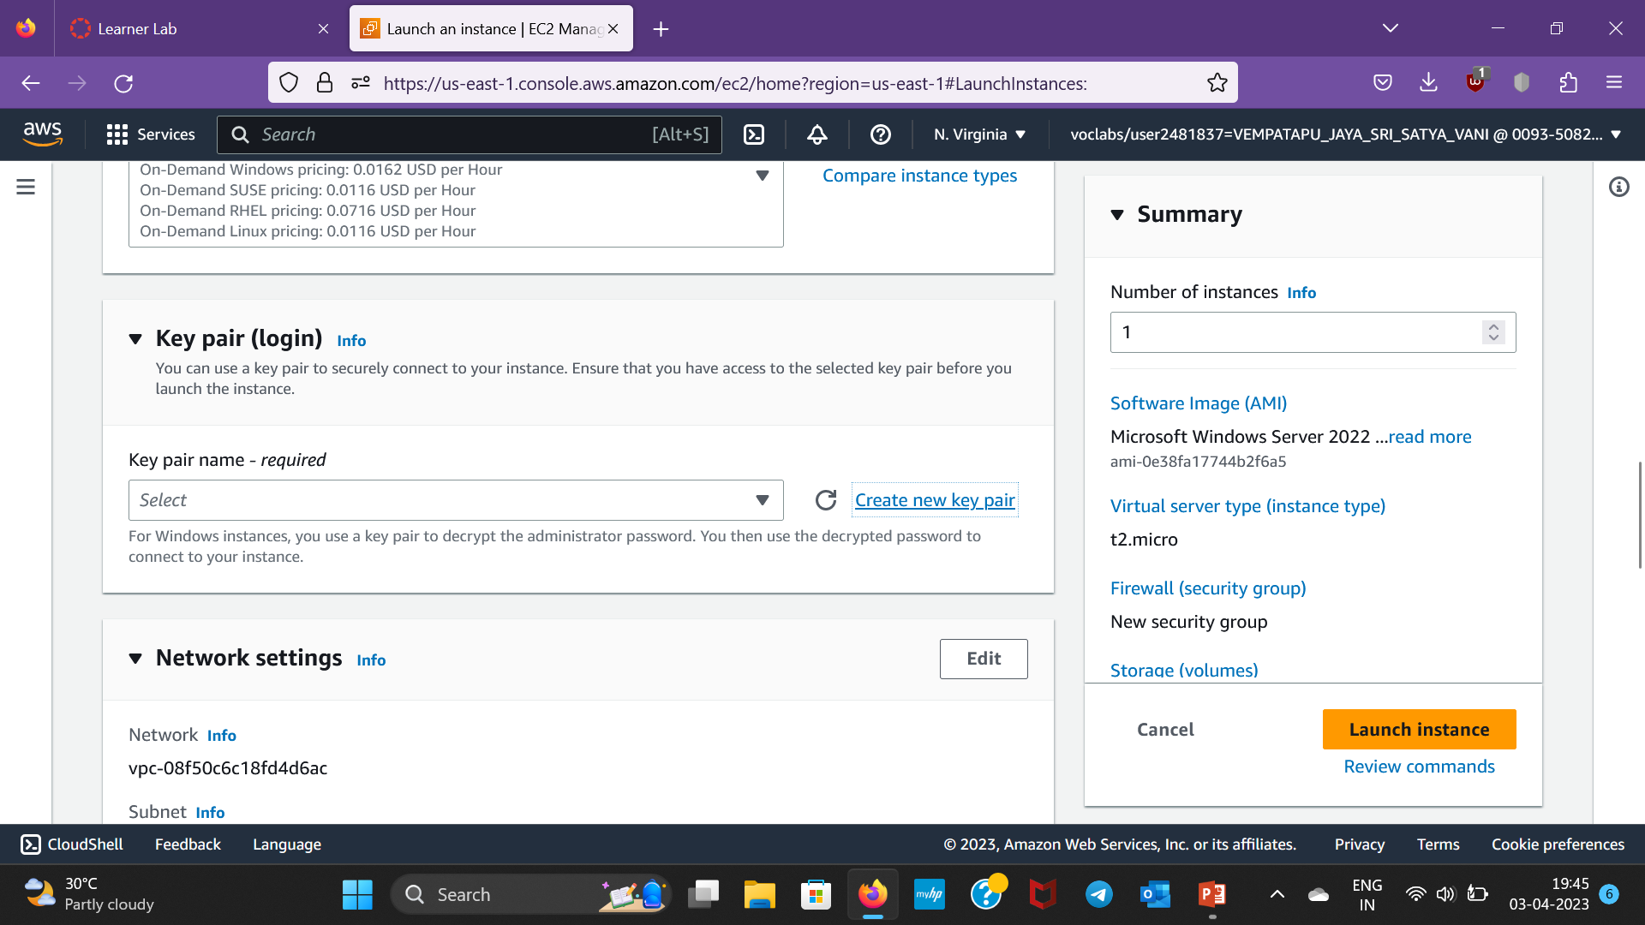
Step-9:We have to create a new keypair

Slide 11
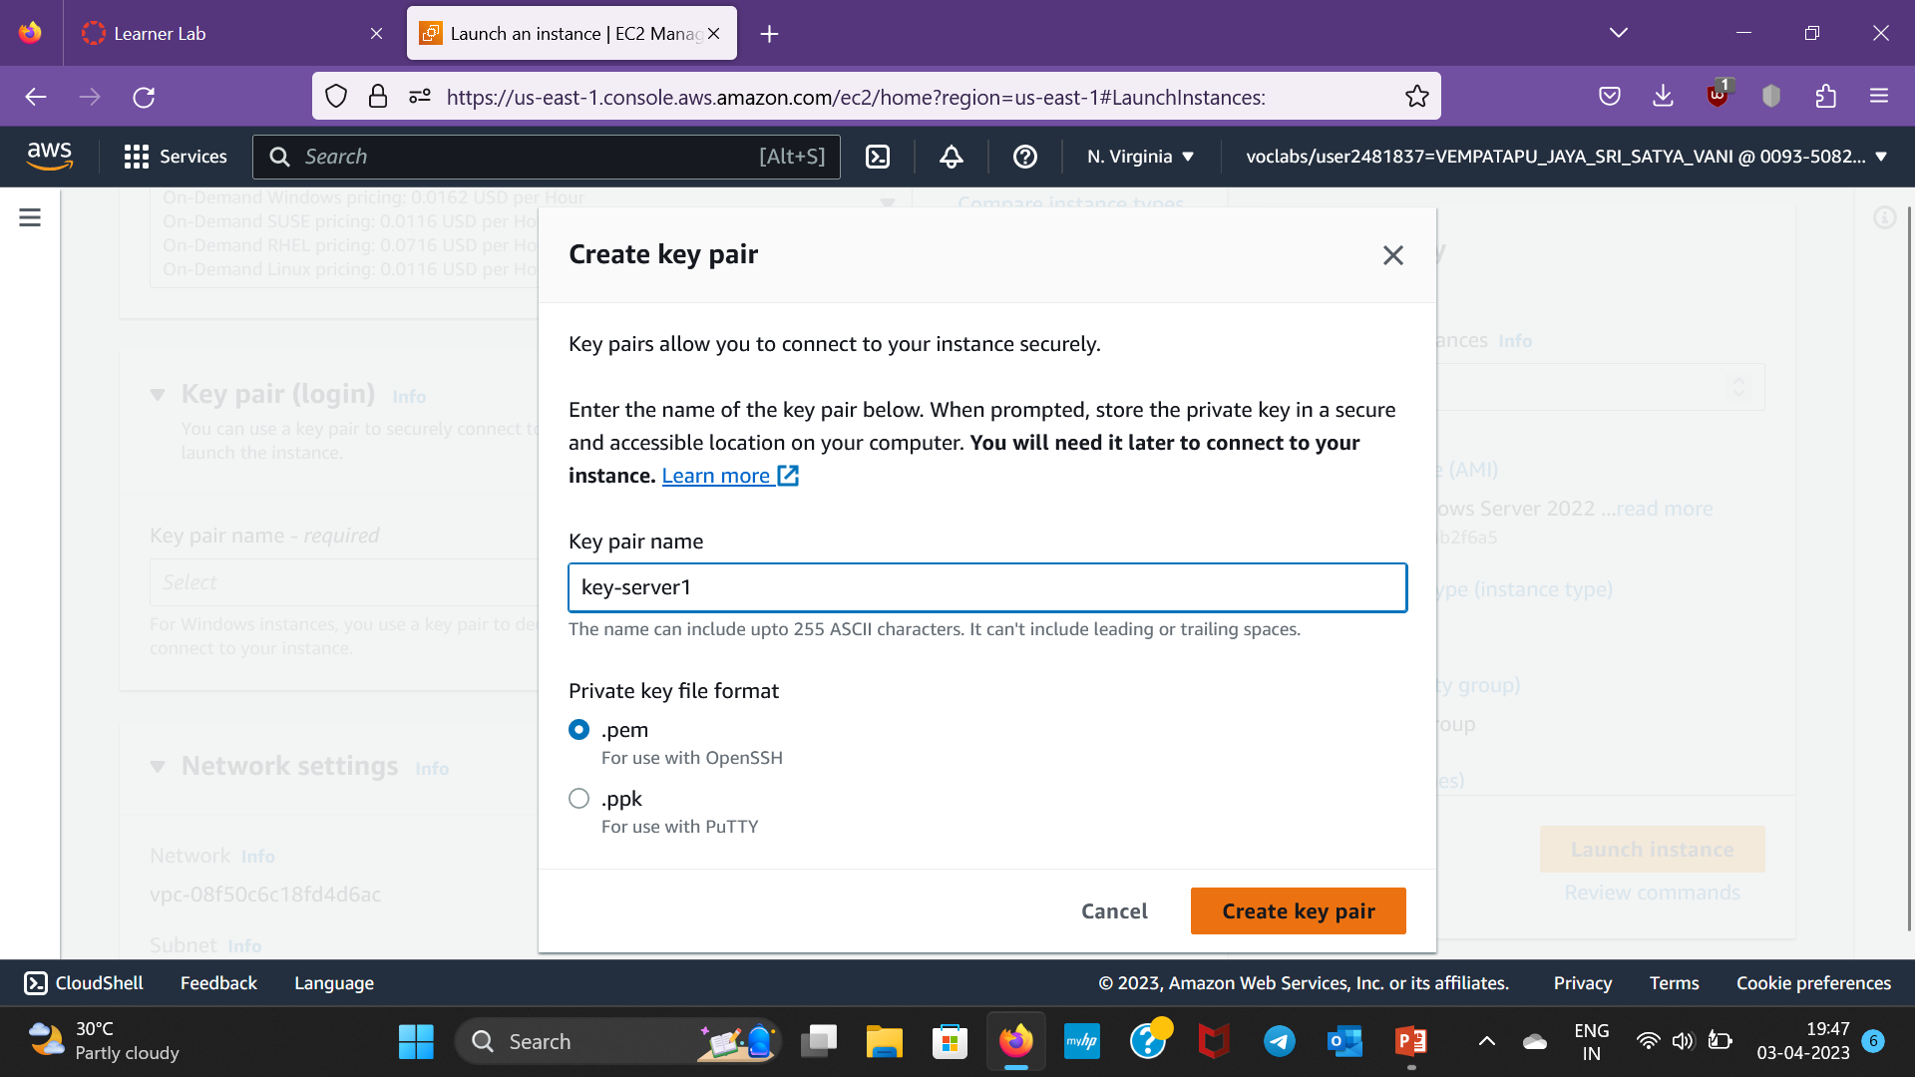
Step-10:Give a key pair name and create key pair

Slide 12
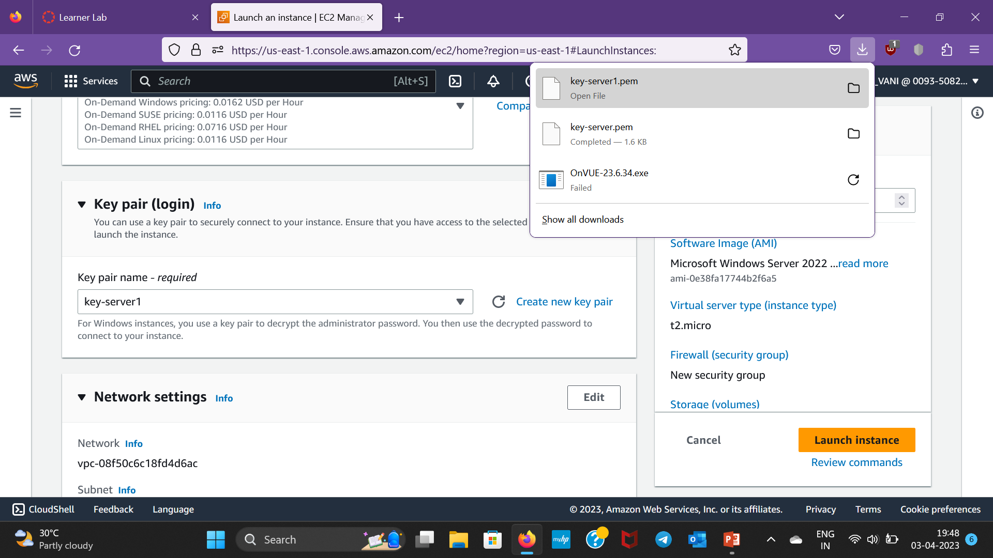
Step-11:Now a pem key is downloaded

Slide 13

Step-12:After that,click on Launch Instance

Slide 14
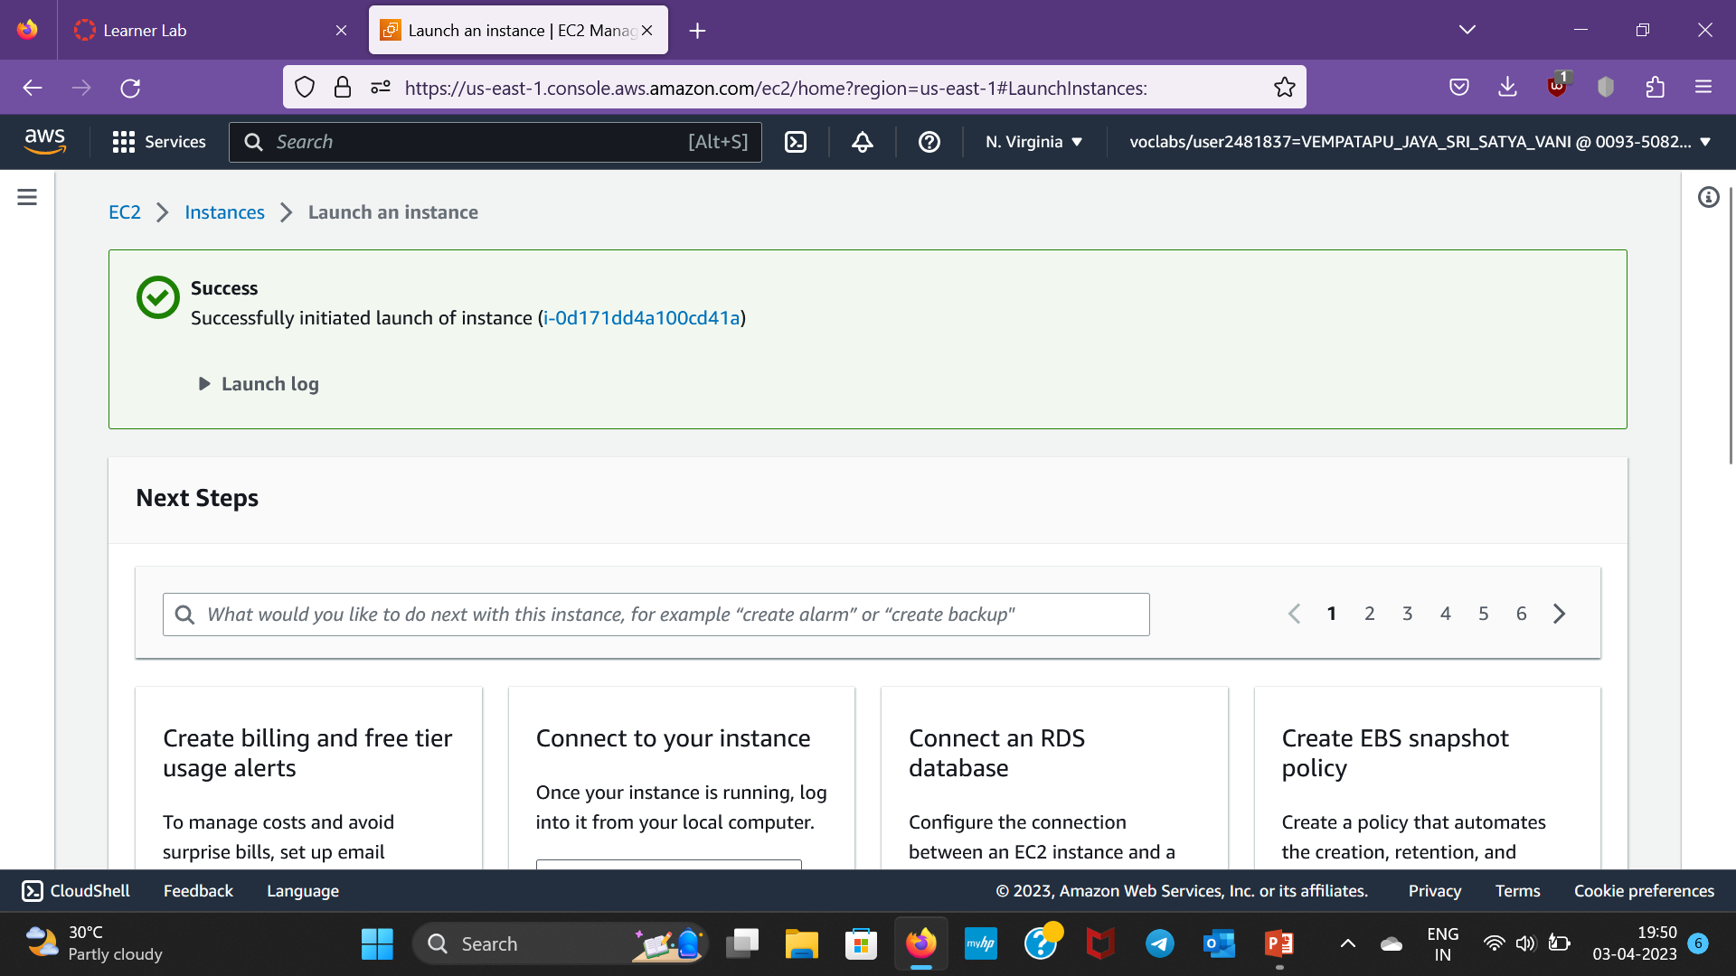
Step 13:The Instance will be Launched

Slide 15
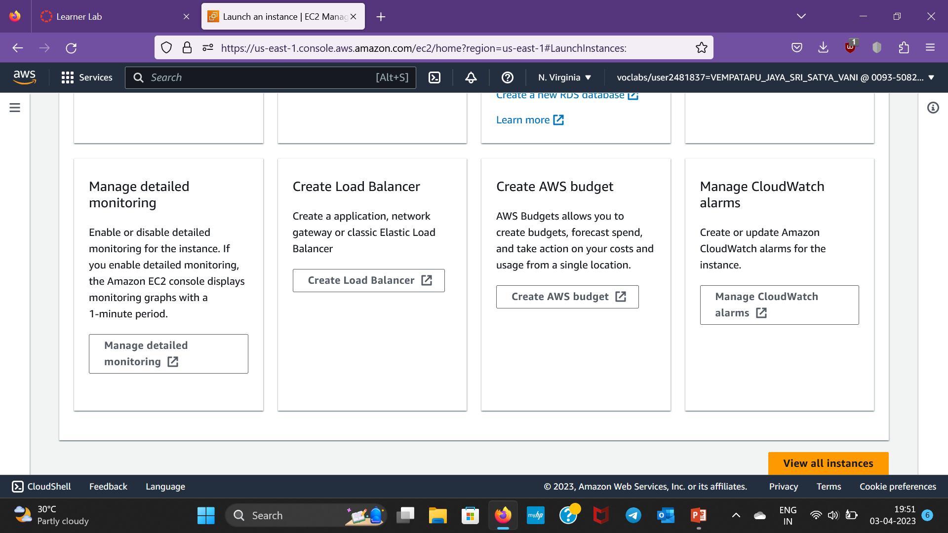
Step-14:Scroll down and click on View Instances

Slide 16
Step 13:The Instance will be Launched

Slide 17

Step-15:We can observe the state of instance here i.e.,running

Slide 18
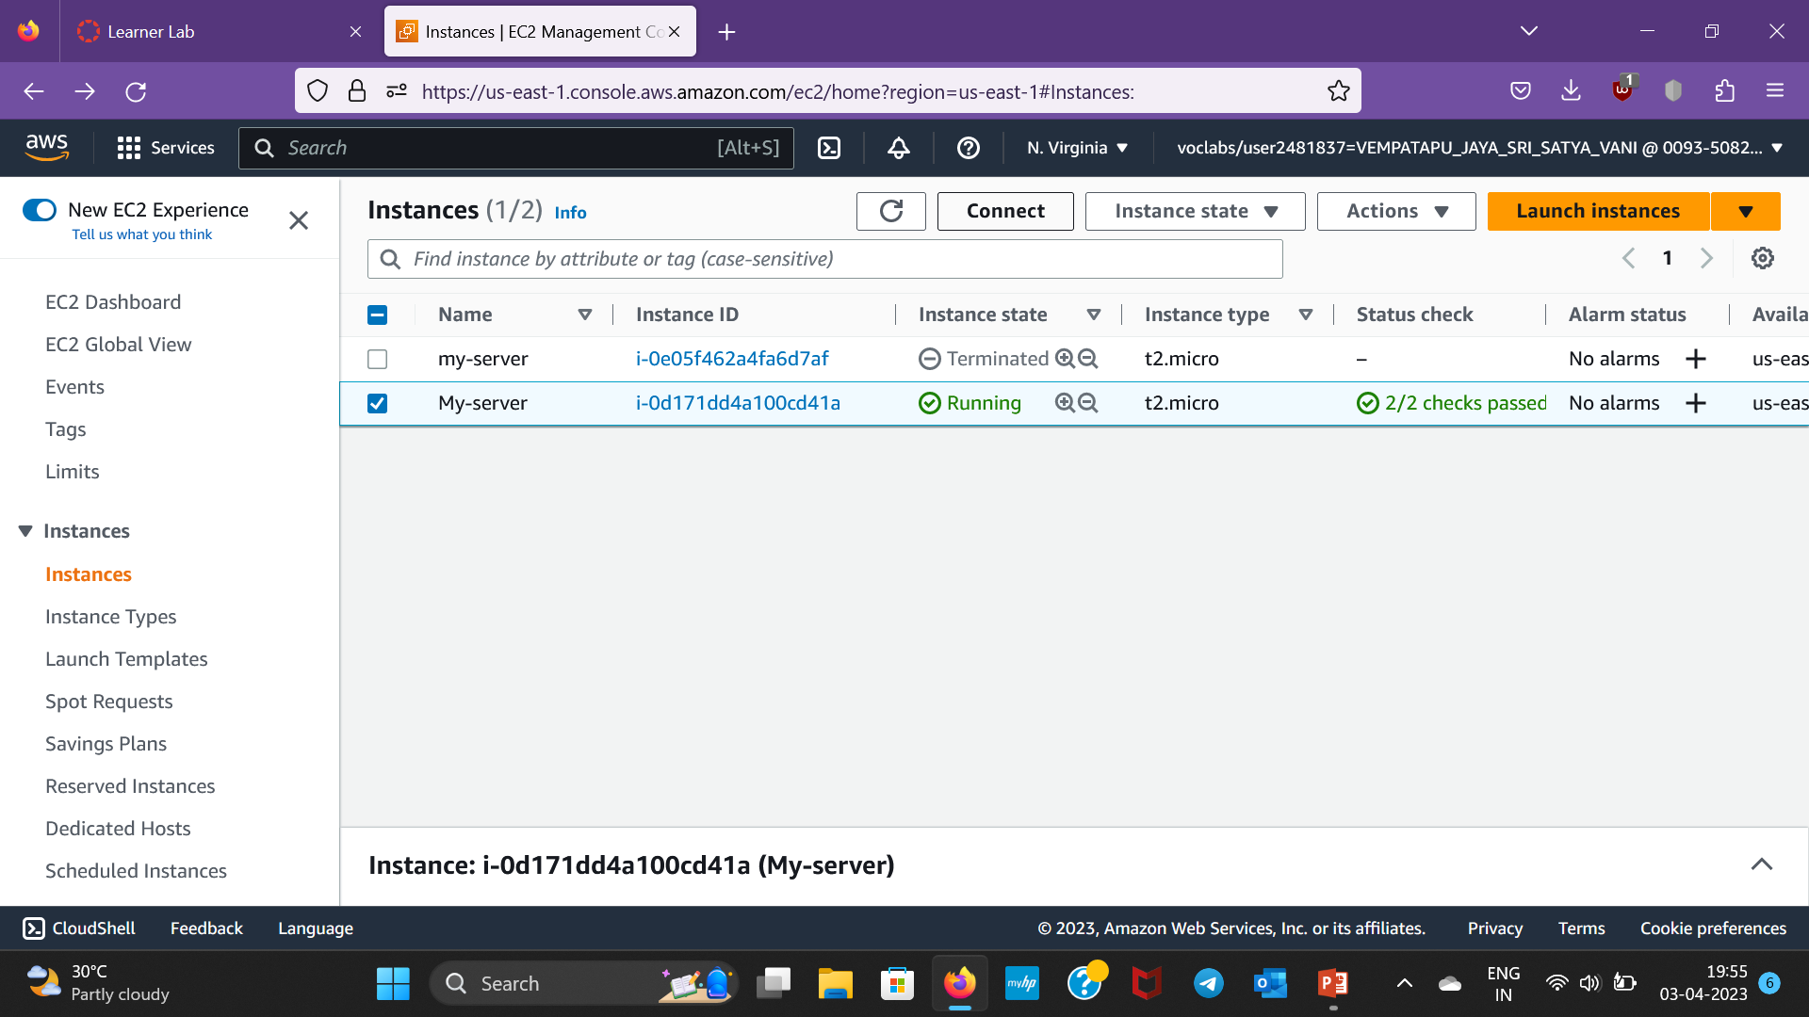
Step-16:Select the instance and click connect

Slide 19
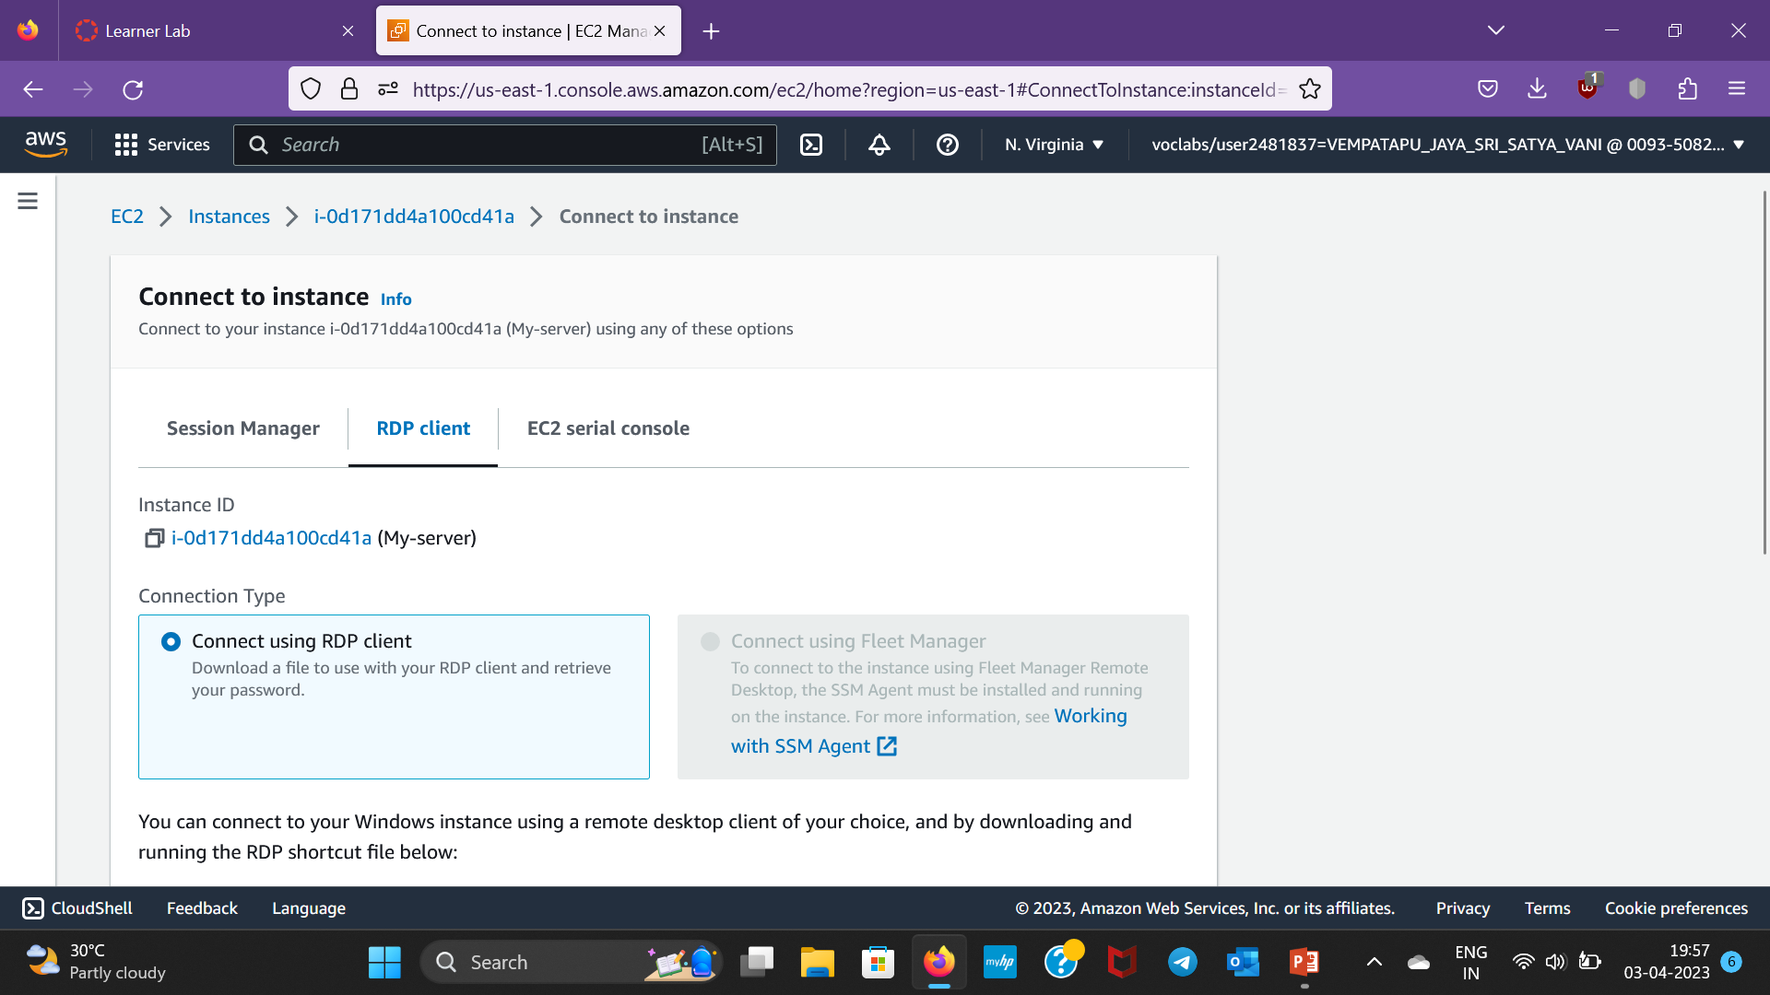
Step-17:After that , click on RDP client

Slide 20
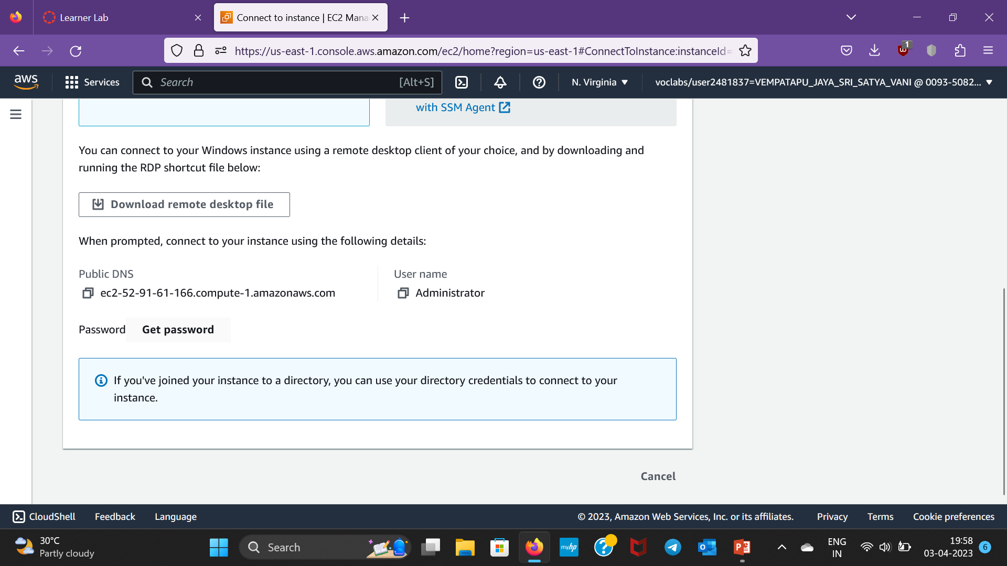
Step-18:Scroll down and click on get password

Slide 21
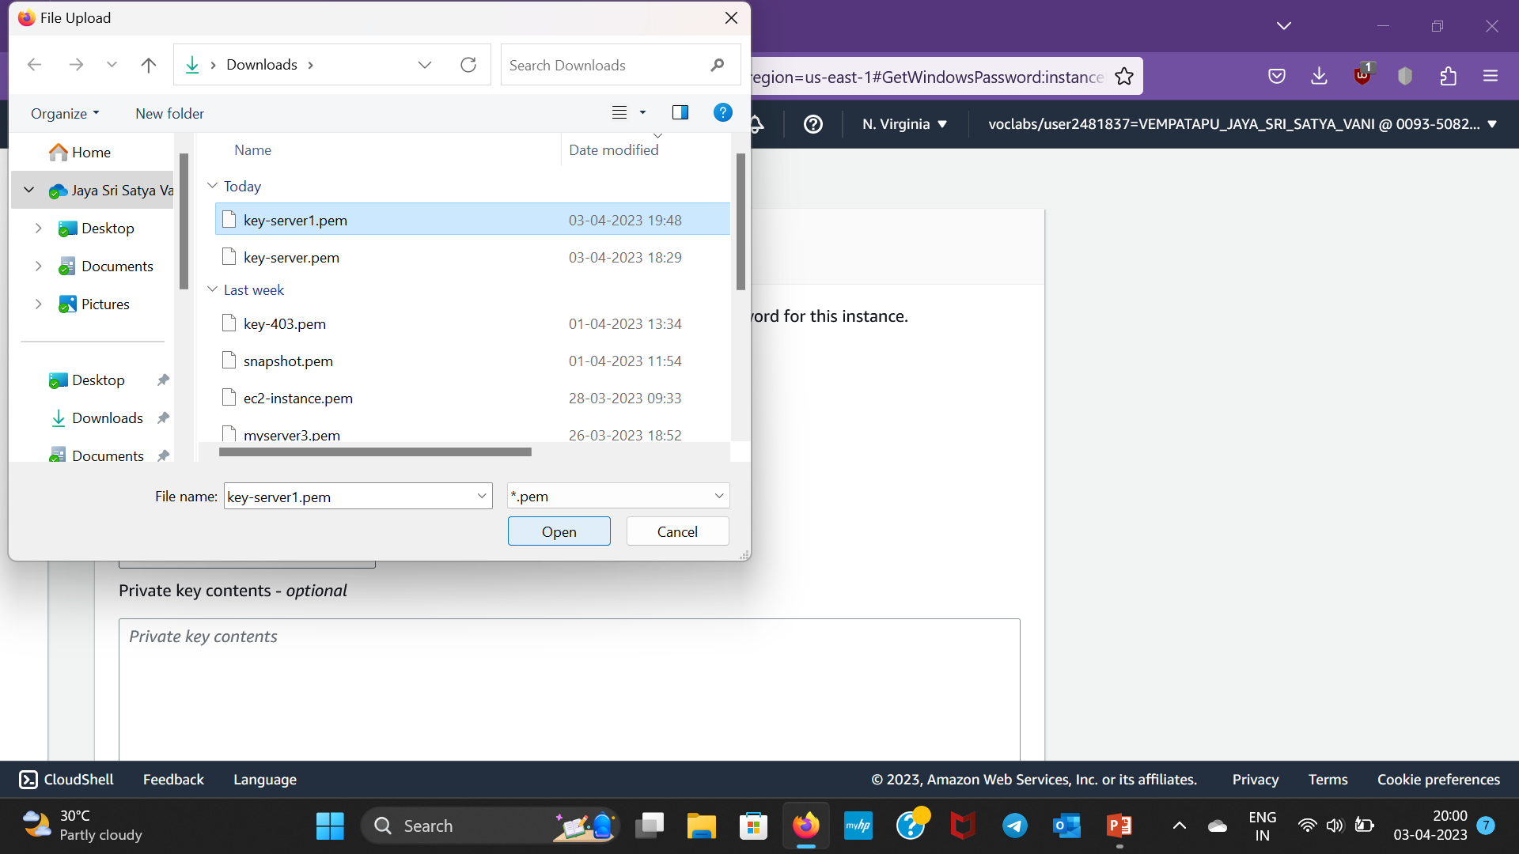
Step-19:Upload private key file which we have downloaded earlier i.e.,keyserver1 keypair

Slide 22
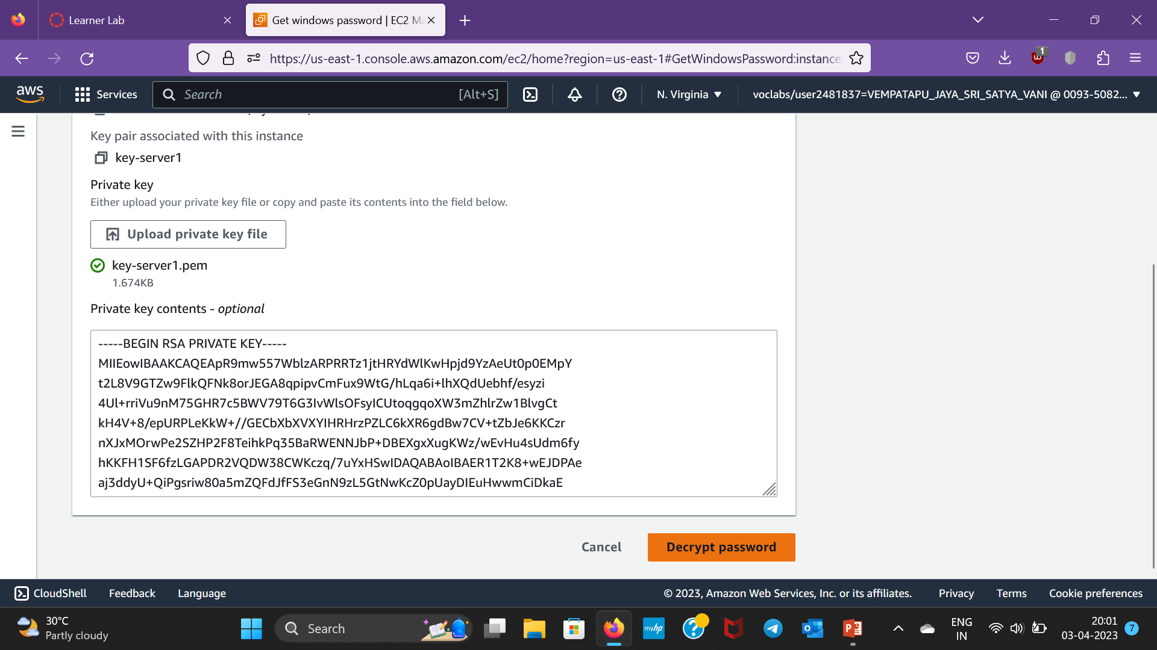
Step-20:Click on Decrypt Password

Slide 23
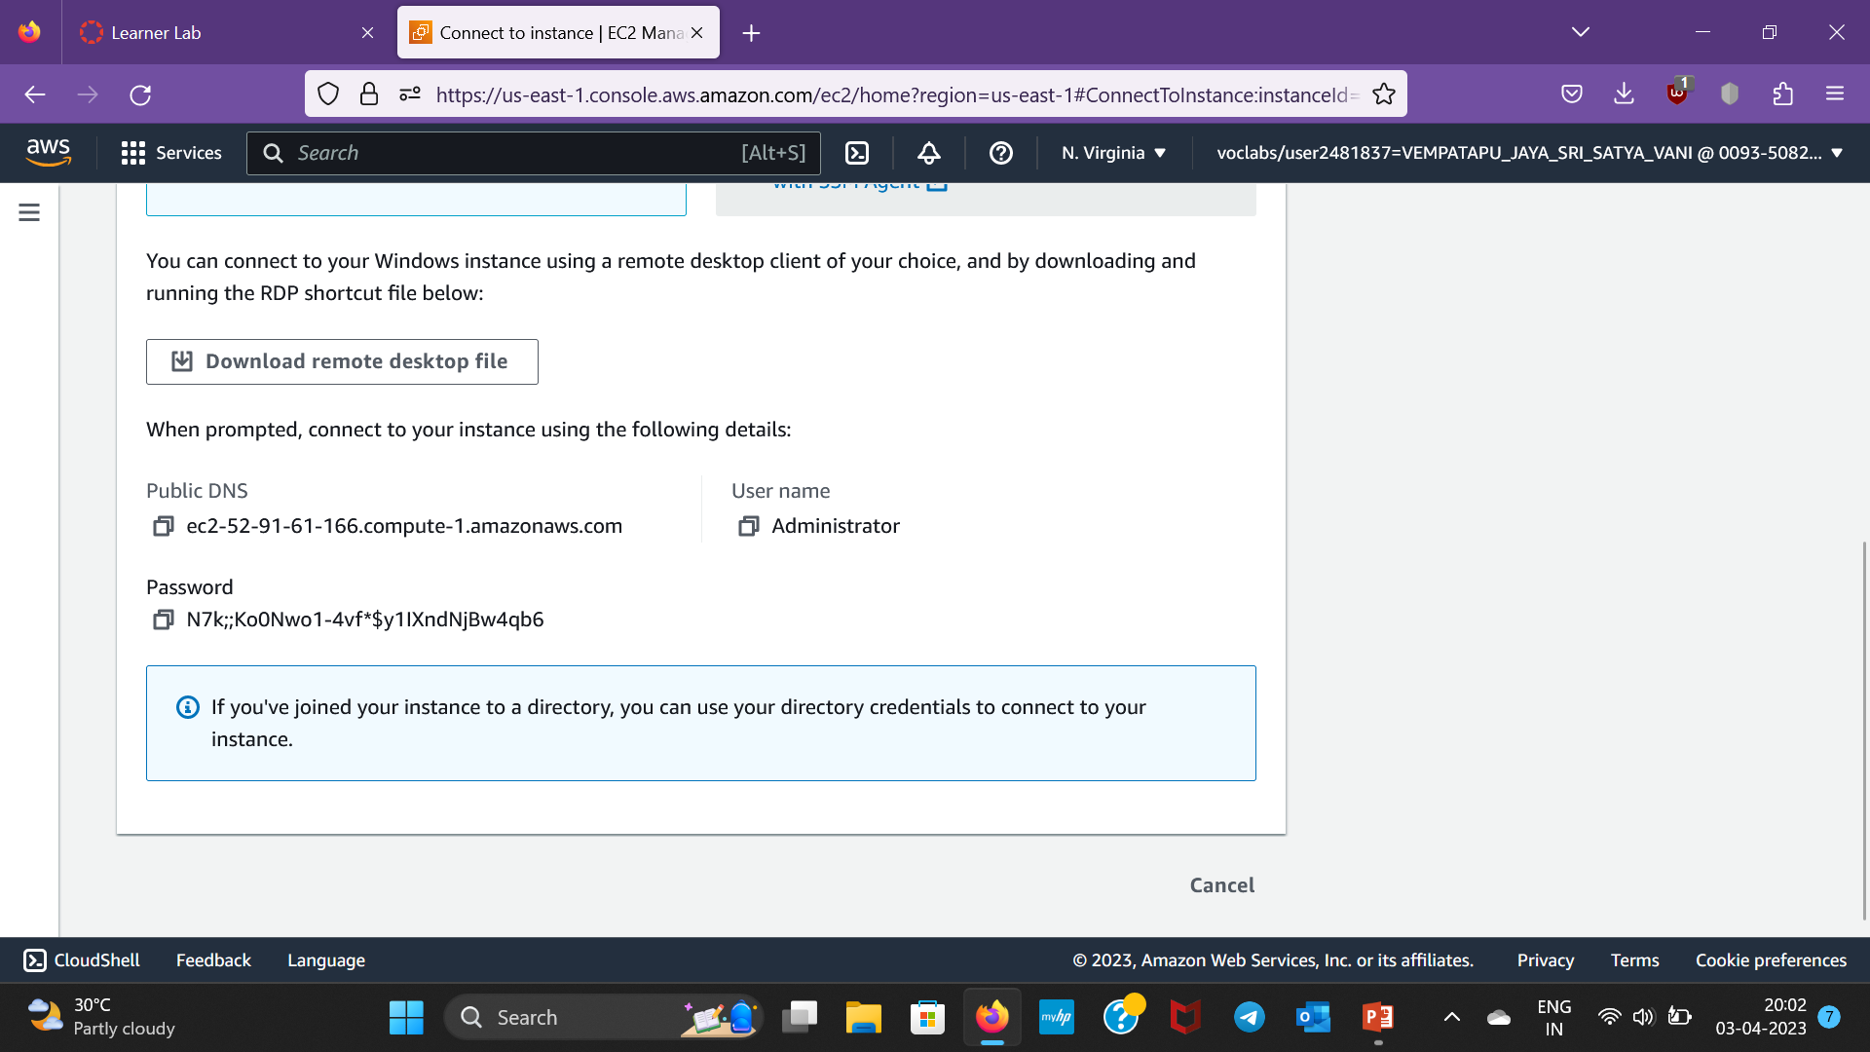
Step-21:After the password is decrypted,the window appears as follows and save the username , public DNS and password

Slide 24
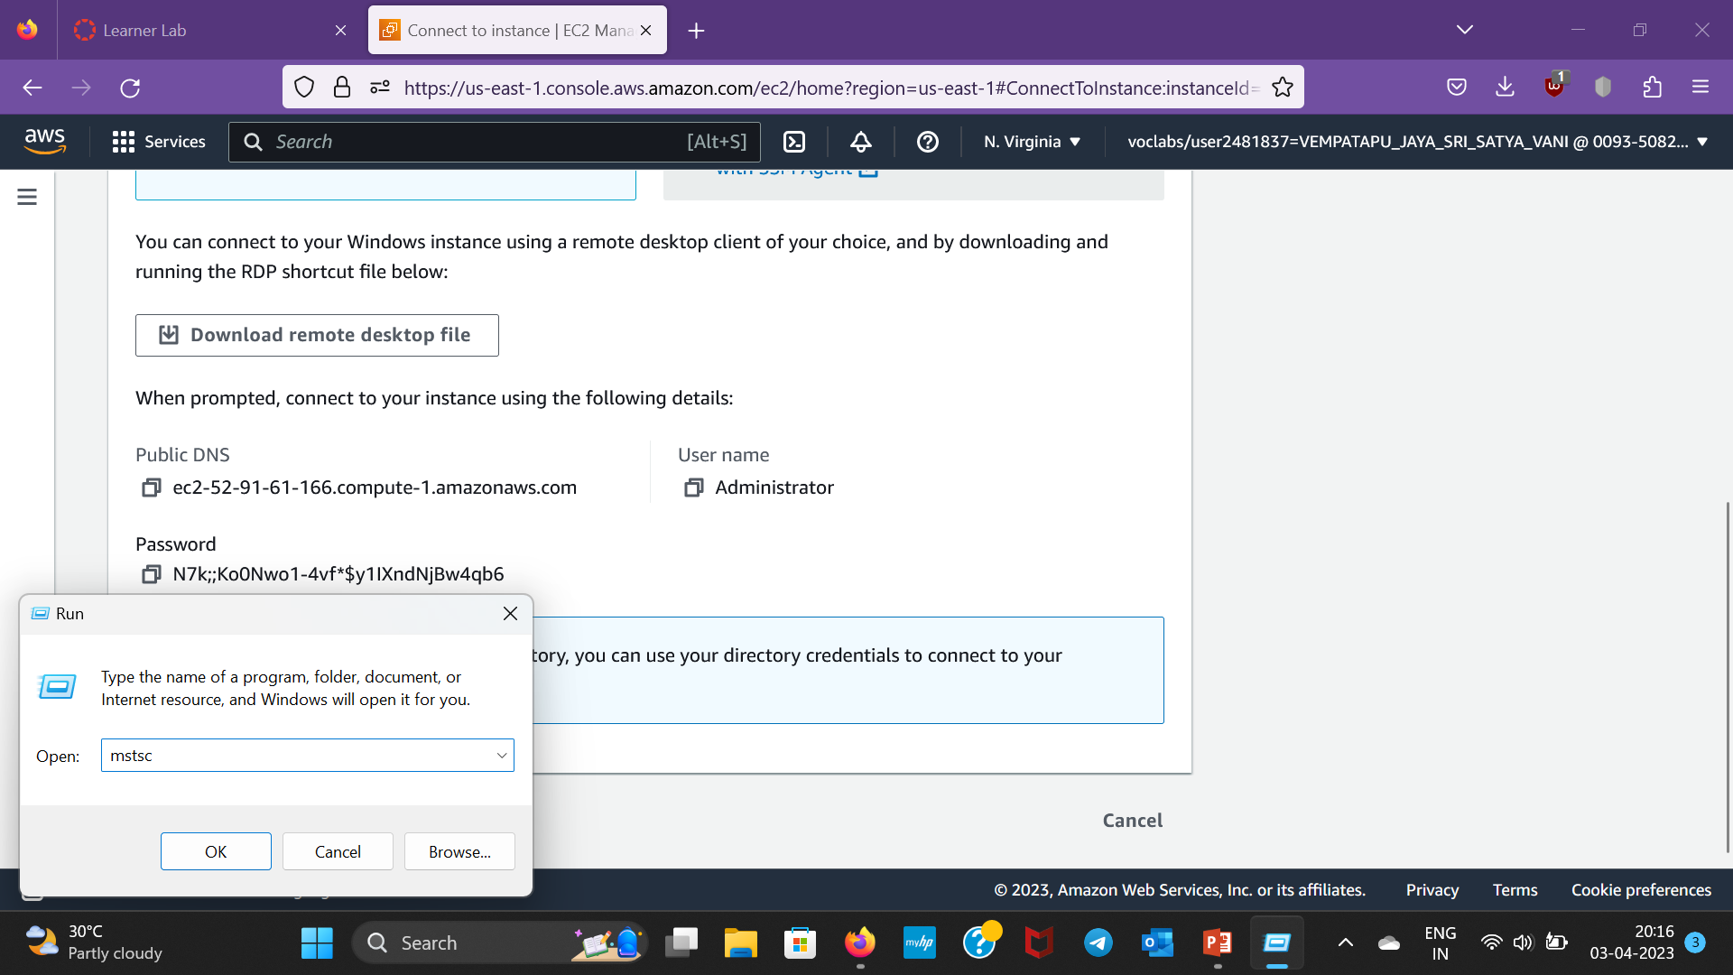
Step-22:Type run on Search bar and open it,then type mstsc and click ok

Slide 25
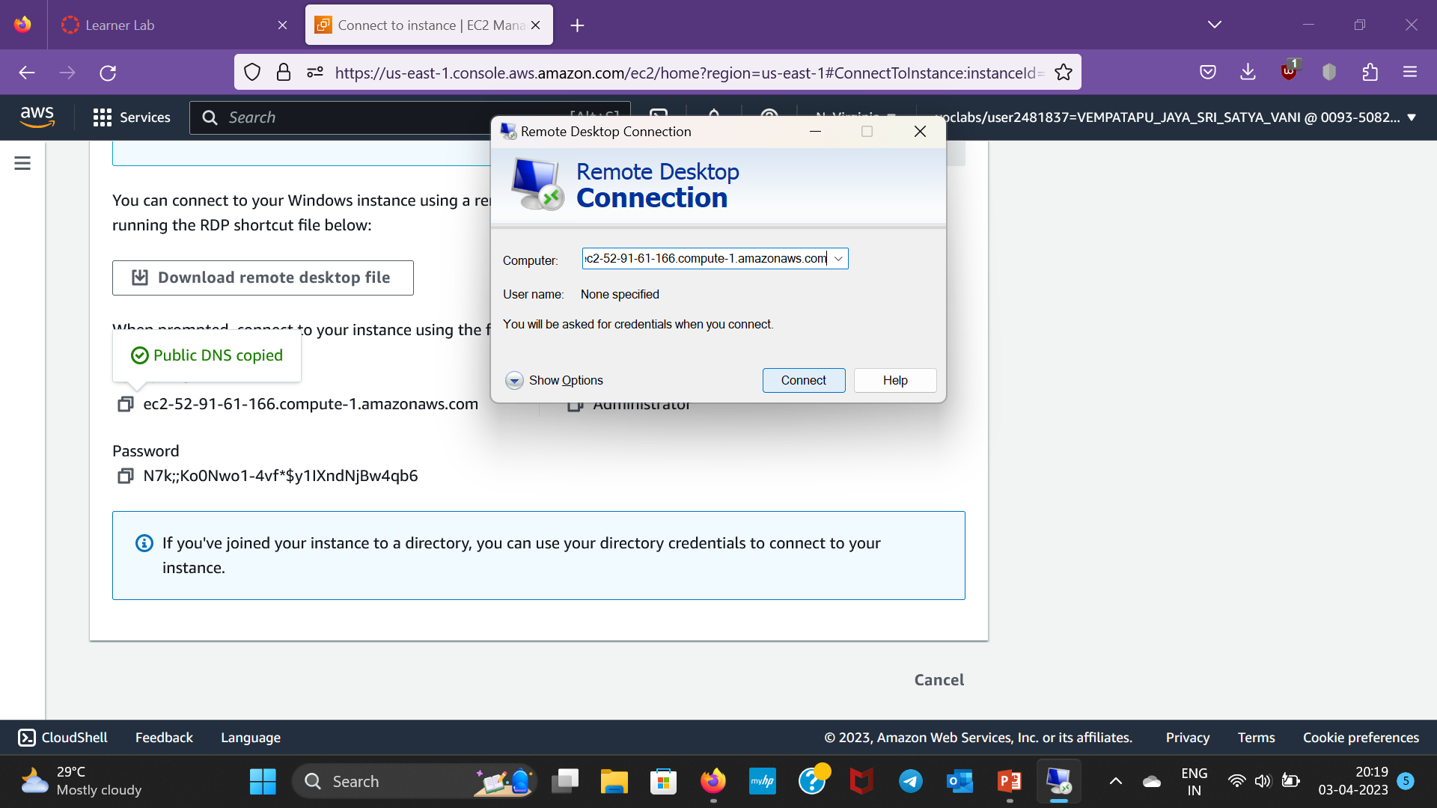
Step-23:Paste the copied DNS name and then click connect

Slide 26
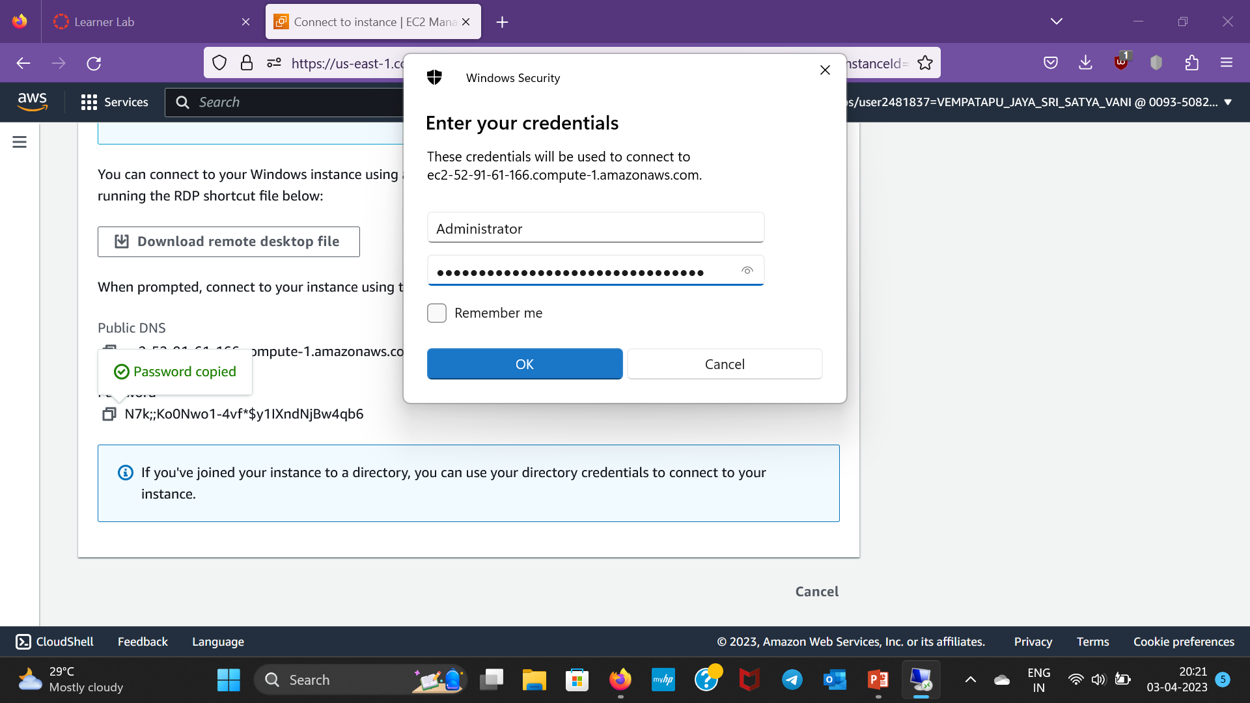
Step-24:Copy and paste the username and password which we copied earlier and then click okay

Slide 27
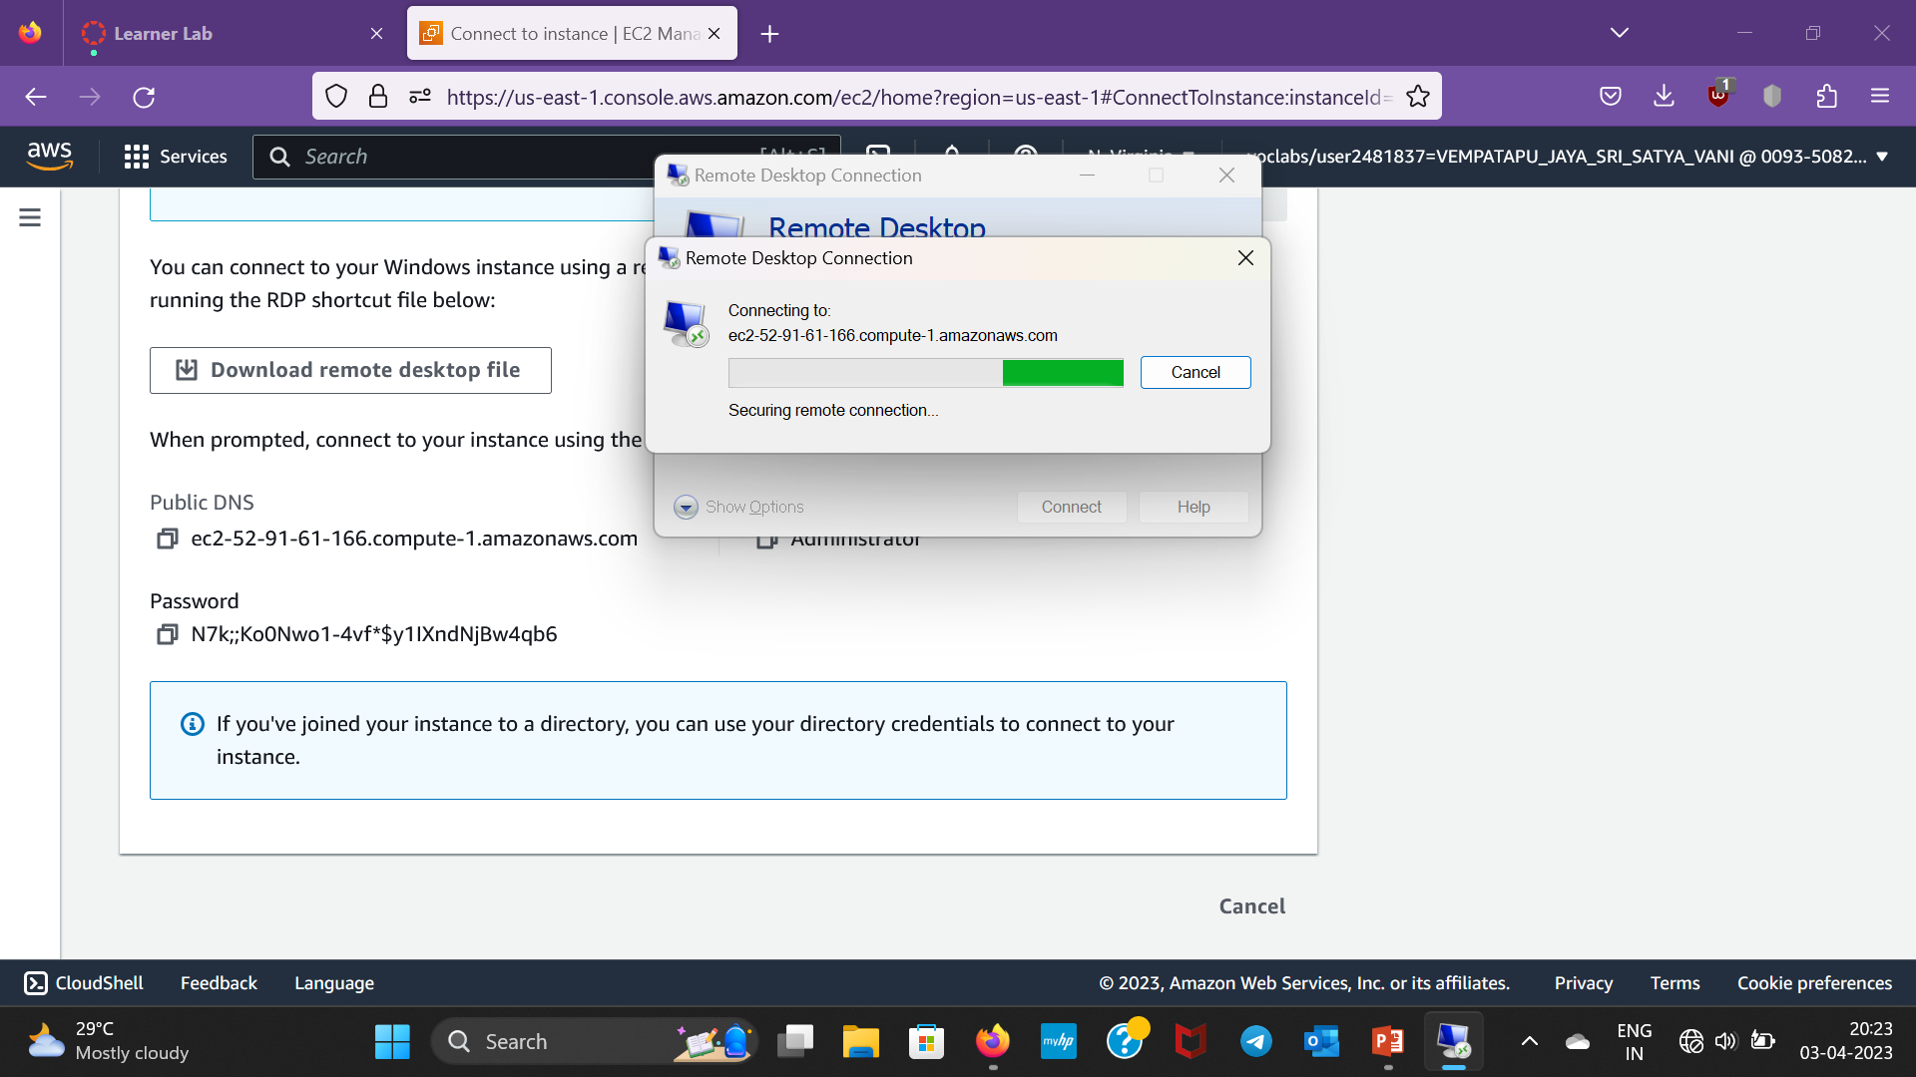
Step-25:Then it’ll connect like as follows

Slide 28
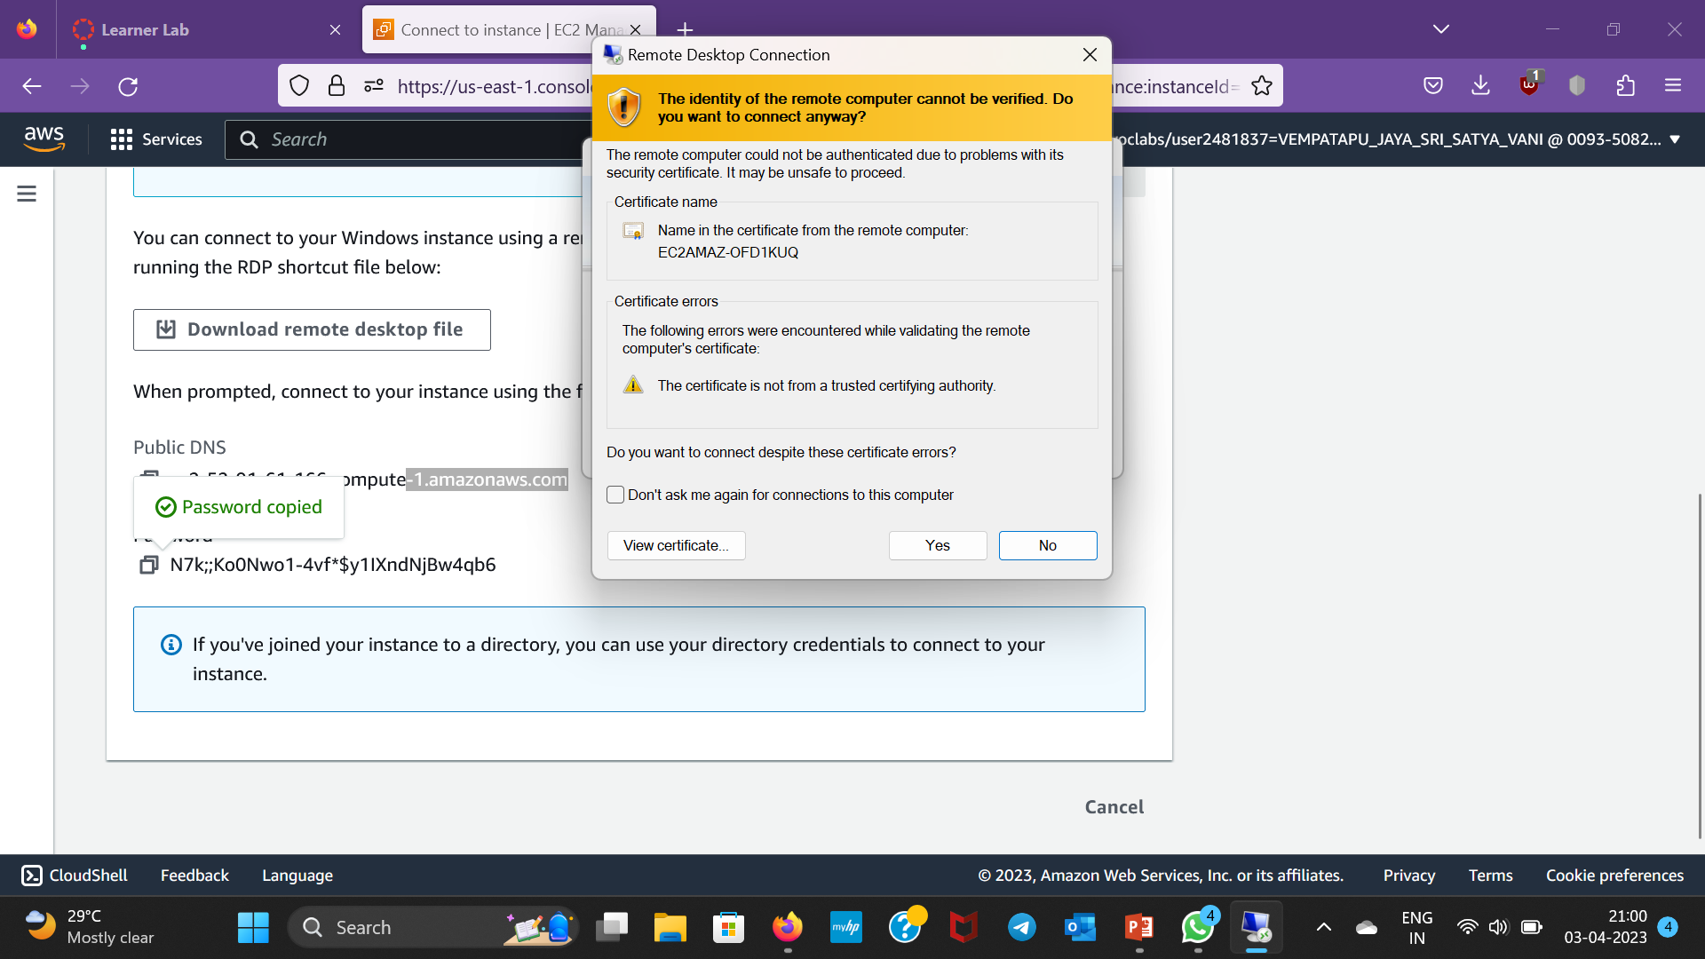
Step-26:Then a pop up window appears,click yes

Slide 29
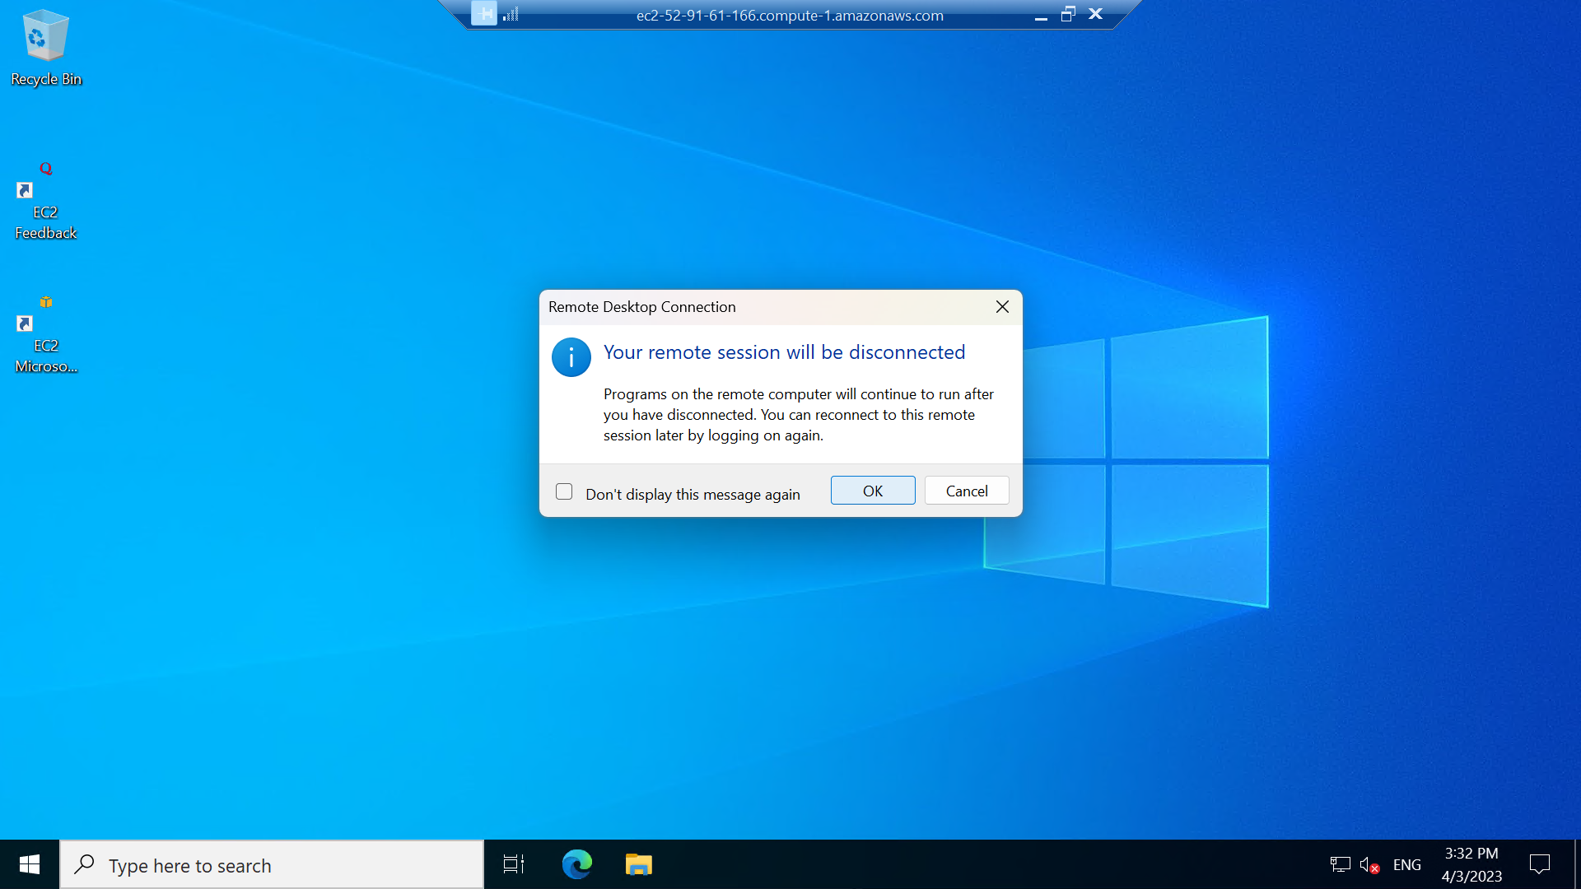
Step-27:Now a Windows desktop appears as follows .To go back to the original desktop click X mark and then click ok

Slide 30
Thankyou

